Slide 1
Lecture 7 Web Service
Dr. Mohamed ElAraby

Slide 2
Objectives
Web Service

Slide 3
Web Service
A web service is a network accessible interface to application functionality, built using standard Internet technologies.
Clients of web services don’t need to know how it is implemented.
Network
Web
Service
Application
client
Application
code

Slide 4
Web Service
Piece of software available over Internet
Uses standardized (i.e., XML, JSON) messaging system
More general definition:
collection of protocols and standards used for exchanging data between applications or systems.

Slide 5
Web Services Architecture
Technologies capable of
Exchanging messages
Describing Web services
Publishing and discovering Web service descriptions

Slide 6
Some Web Service Standards
REST (Representational State Transfer)
Architecture style of networked systems
SOAP (Simple Object Access Protocol)
Standard for sending messages between applications
WSDL (Web Service Description Language)
Standard for describing web services and their capabilities

Slide 7
REST
Representational State Transfer
Architectural style (technically not a standard)
Idea: a network of web pages where the client progresses through an application by selecting links
When client traverses link, accesses new resource (i.e., transfers state)
Uses existing standards, e.g., HTTP

Slide 8
REST Characteristics
Client-Server: Clients pull representations
Stateless: each request from client to server must contain all needed information.
Uniform interface: all resources are accessed with a generic interface (HTTP-based)
Interconnected resource representations
Layered components - intermediaries, such as proxy servers, cache servers, to improve performance, security
Notes:
Named resources: resources named using a URL.
: representations of resources are interconnected using URLs

Slide 9
REST examples
The Web is RESTful (a bunch of HTTP links)
EBI (European Bioinformatics Institute)
http://www.ebi.ac.uk/xembl
Dbfetch – retrieve entries from EMBL nucleotide sequence database
http://www.ebi.ac.uk/cgi-bin/abc/dbfetch?db=embl&id=x12399&format=default
Header params
Request body (post load / payload)

Slide 10
SOAP
Simple Object Access Protocol
Format for sending messages over Internet between programs
XML-based
eXtensible Markup Language:(XML)
Platform and language independent
Simple and extensible
Stateless, one-way
But applications can create more complex interaction patterns
Notes:
<XML/>
<student>
<name>Mohamed</name>
<age>10</age>
<address> 13 st fgdf </address>
</student>
{
“name”:”Mohamed”,
“age”:”10”,
“address”:”fdsfsdf”
}

Slide 11
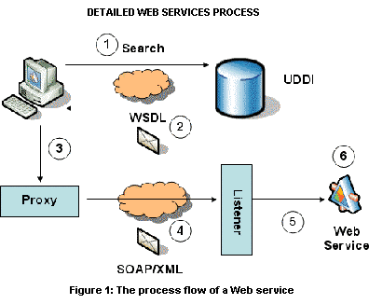
SOAP

Slide 12
SOAP Building Blocks
Envelope (required) – identifies XML document as SOAP message
Header (optional) – contains header information
Body (required) –call and response information
Fault (optional) – errors that occurred while processing message

Slide 13
Simple Example
“Get the price of apples”
<?xml version="1.0"?>
<soap:Envelope xmlns:soap="http://www.w3.org/2001/12/soap-envelope" soap:encodingStyle="http://www.w3.org/2001/12/soap-encoding">
<soap:Body>
<m:GetPrice xmlns:m="http://www.w3schools.com/prices">
<m:Item>Apples</m:Item>
</m:GetPrice>
</soap:Body>
</soap:Envelope>
Note:GetPrice and Item are application-specific (not part of SOAP)

Slide 14
Summary: SOAP vs. REST
REST – clients submit requests to Web services as HTTP requests
SOAP – clients submit request in form of XML document

Slide 15
SOAP vs. REST
SOAP advantages:
Widely used and supported
Supports variety of protocols (network transfer, authentication, encryption)
REST advantages:
Simple, relies only on HTTP protocol
Performance and reliability
Many sites support both SOAP and RESTful interfaces
Amazon.com, XEMBL from EBI

Slide 16
WSDL (Web Service Description Language)
Standard method of describing Web Services and their capabilities
Idea: Automate details involved in applications communication
Operations and messages are described abstractly
Bound to a concrete network protocol and message format to define an endpoint
Provide documentation for distributed systems

Slide 17
WSDL Details
A WSDL document defines services
Web Services Description Language (WSDL)
Directory Services
Universal Description, Discovery, and Integration (UDDI)
Services are collection of network endpoints (ports)
Abstract definition of endpoints and messages is separated from their concrete network deployment or data format bindings
Allows the reuse of abstract definitions:
messages -abstract descriptions of data being exchanged
port types -abstract collections of operations
concrete protocol and data format specifications for a particular port type constitutes a reusable binding

Slide 18
Web Services: Basic Architecture
Service
Broker
Registry; well-known
Publish or announce
(WSDL)
Find or discover
(UDDI)
Service
Provider
Bind or invoke
(SOAP)
Service
Requestor
Not well-known

Slide 19
WSDL ←→ UDDI

Slide 20
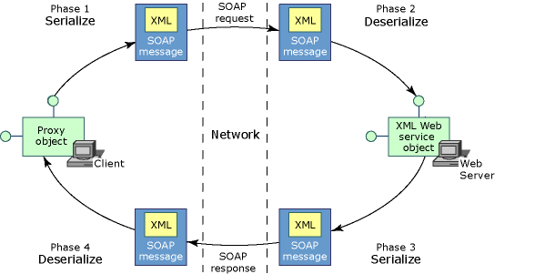
Web Services-SOAP Standards Based Approach
Definition: Simple Object Access Protocol
Function: SOAP is an envelope that a request for resources is packaged in. It includes a header and body.
The header can include information about security, recipients, handling, routing, etc.
The body includes a standard XML request
Notes:
The target operation is hidden inside the Soap envelope. A soap server has parse the SOAP message inside the envelope to determine what procedure to invoke. All messages are sent with HTTP post.
SOAP 1.1 met with some criticism from the REST community
Example: Security is handled within the SOAP message rather than by HTTP.

Slide 21
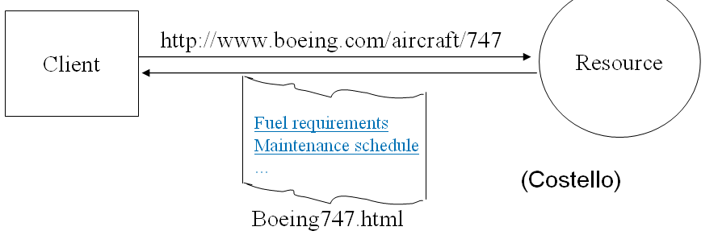
Web Services-REST Non-Standards Based Approach
Definition: Representation State Transfer
Function: REST is an architectural style for accessing distributed media or resources.
Notes:
REST was named by Roy Fielding. REST is not a standards based approach, it is an architectural style for distributed hypermedia. The modern WWW is to a large degree an implementation of this style. REST uses standards like HTTP, URL, and XML.
Clients are state machines. Progress (transfer) from one state to another is achieved by receiving representations of resources.
Links are representations. Web pages are states.

Slide 22
Summary of REST and SOAP
REST
Messages are represented in plain/JSON/XML.
HTTP is used for the transfer protocol.
HTTP verbs are used for access/manipulation commands.
URIs are used to uniquely identify resources in message.
HTTP authentication provides security.
There is no formal method for expressing the interface contract.
SOAP
Messages are represented in a standardized XML SOAP "envelope“.
Can be bound to various protocols including HTTP and SMTP.
Access to and manipulation of data are application specific.
Security is not described by SOAP and is to be provided by the developer.
XML schemas or DTD are used to define the contract between client and service.
Notes:
XML Schema or DTD is used with SOAP.

Slide 23
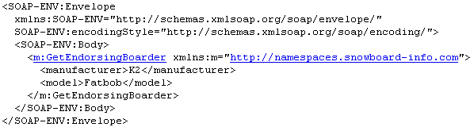
Key Topics to Remember
Summary
WSDL: Standards-Based Description language for making resource requests
SOAP: Standards-Based Envelope for delivering the request
REST: Messages are represented in plain (pure) XML only
UDDI: Voluntary registry for listing and finding web services (Yellow Pages)
Notes:
Now that we’ve given you a few examples of how people are using web services we want to go over some key topics.

Slide 24
Any Question?

